Slide 1
High Level Operational Support Model TB982 – Optus Digital Agency (ODA)
Prepared by: Dante Lorredo
Date: 1st May 2012
V0.3

Slide 2
Optus Digital Agency
Objective: The Optus Digital Agency (ODA) project is an SMB initiative to provide a range of digital advertising solutions to Optus SMB customers. The goal and vision is to create a one-stop shop for SMB customers to purchase online advertising (presence and relevance) tools and services for the SMB to generate cost effective sales leads via the web.
Target RFS Dates:
Phase1 - SEO (BETA Release ) 9th May 2012
BRT : SEO 10th May – 22nd May 2012
Phase2 - SEO Downgrade/Upgrade: 16th May 2012
Commercial Launch SEO: 23nd May 2012
Phase3 - SEM Downgarde/Upgrade: 25th Jun 2012
BRT: SEM 26th Jun – 9th July 2012
Commercial Launch SEM: 10th July 2012

Slide 3
Key functions by Delivery Phase
Release1 – 9th May (BETA) BRT – starts 11th May | Release2 – 16th May SEO Commercial Launch – 23rd May | Release3 – 26th Jun SEO Commercial Launch – 10th Jul
SODA Quote –SEO (deferred to later release) | SODA Quote – SEO/downgrade/upgrade | SODA Quote – SEO/SEM downgrade/upgrade
SODA Order - SEO | SODA Order - SEO downgrade/upgrade | SODA Order - SEO/SEM downgrade/upgrade
iProcess - SEO | iProcess SEO downgrade/upgrade | iProcess SEO/SEM downgrade/upgrade
TSA 1.1 & 1.2 – SEO site deployment) | TSA1.1 & 1.2 – SEO downgrade/upgrade site deployment | TSA 1.3 – SEO /SEM downgrade/upgrade site deployment
TSA – NCS interface (SaaS Connect) iProcess – NCS interface (Saas Connect) | TSA Reporting files extract to DCS | Soda Txn Log back up
Self Serve UI log-in –user creation and authentication, website update | Vertica to SODA Call Report Extract SODA to forward report to TSA | iProcess Txn Log back up
WAM Site Minder Configuration | DCS - IDW Reporting files in to SRD | Proxy & Load Balancing Final Solution including DB replication
SODA to Melbourne IT SODA ABN Registry iProcess to Melbourne IT |  | Performance Test Result
Mascot Proxy Interim Solution |  | SODA – customer email notification
 |  | TSA customer email notification
 |  | Rebuild of Admax servers in Tier 2

Slide 4
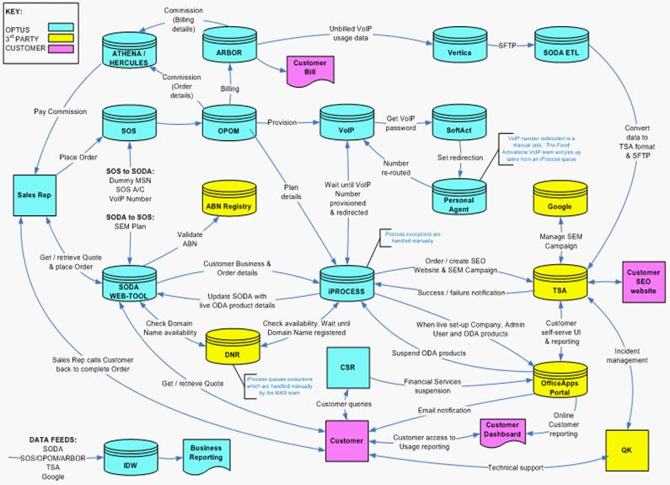
Project ODA : Business Txn Flow Flow

Slide 5


Project ODA : Customer Support Flows and Systems
Desktop Support Client /
Web Form
QK Ticketing System
Google
Ticketing
NCS
Ticketing
OfficeApps
Support
F-Secure
Ticketing
QK Tech Support
Tech support
Melbourne IT
Partner Control
Customer
Phone
133343
Internet
Connectivity
IFMS
ODA
Optus IPS
Tier1 – Billing & General
Self Serve UI Log-in
SODA, iProcess
Infrastructure, environment, etc
MAS Tier 2
Optus Help Desk
O
D
A
Website Apps Support
TSA
Infrastructure, environment, systems outages, performance issues

Slide 6
Application Support Team
System | Support Team | Portfolio/Support Manager
TSA | The Search Agency | Christopher Lynch
TSA Host Environment - Mascot | Support Services, SSI | David Turner
TSA Proxy/Load Balancer - Mascot | Support Services, SSI | David Turner
TSA Database back up and replication | ???
iProcess | On Line Sales & CC Operations (Accenture) | Bindu Subhadramma
SODA Quote/Order | IT Web Support | Sanjib Biswas
SODA - WAM/SiteMinder Configuraion | IT Web Support | Sanjib Biswas
Proxy - SPOC | IT Web Support | Sanjib Biswas
IDW - Report Files into SRD | IDW Service Operations | Karen Waller
Vertica – Call Extract | Billing Service Operations | Ross Burke
Intermediate (DCS) – TSA Statistical Report Files | Billing Service Operations | Ross Burke

Slide 7
Business Support Team
Resource | Role | Contact
Daniel Ringrose | ODM Portfolio Manager | 8082 7275 0416 074 646
Kendall Tucker | Business Project Manager | 8082 8290 0414 303 321
Jesse Snow | Business Owner | 8082 7762 0404 897 731
Andrew Kim | Product Manager | 8082 8021 0411 880 018
Tier 1 Support Team c/o Robert Hanimyan | Billing & General Support | 8082 9676 0419 431 304
MAS Tier 2 Support Team c/o Robert Hanimyan | ODA Support | 8082 9676 0419 431 304
Steve Friend | Business Service Assurance | 8462 6026 0423 608 424

Slide 8
Customer Interaction Map

Slide 9
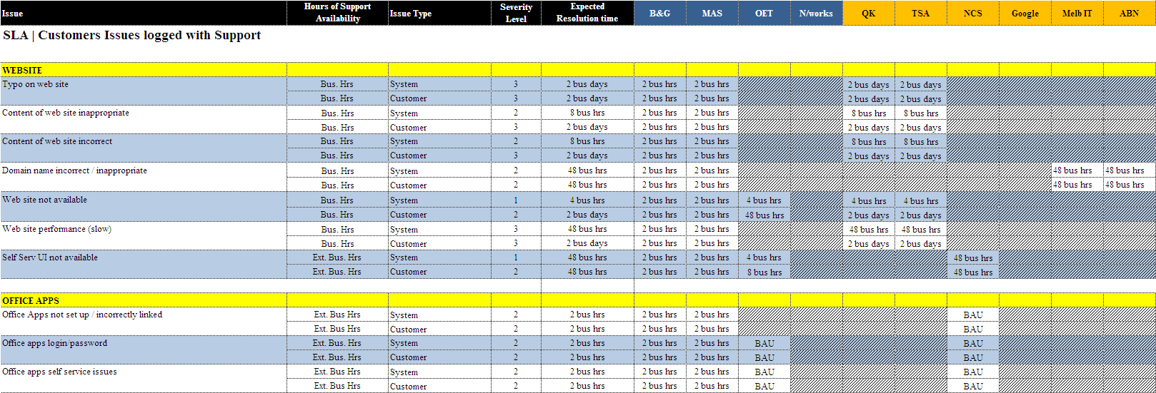
ODA - SLA

Slide 10
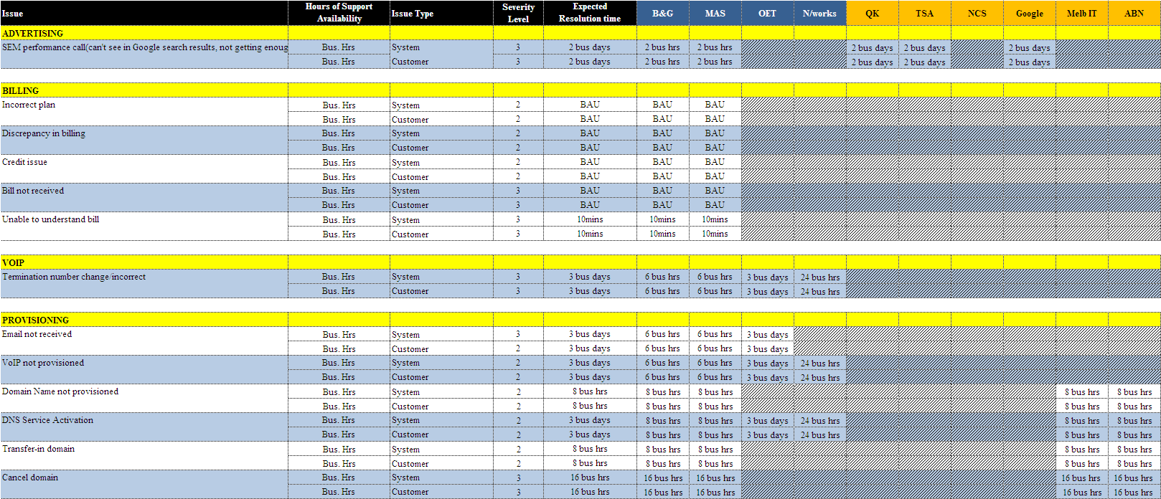
ODA - SLA

Slide 11
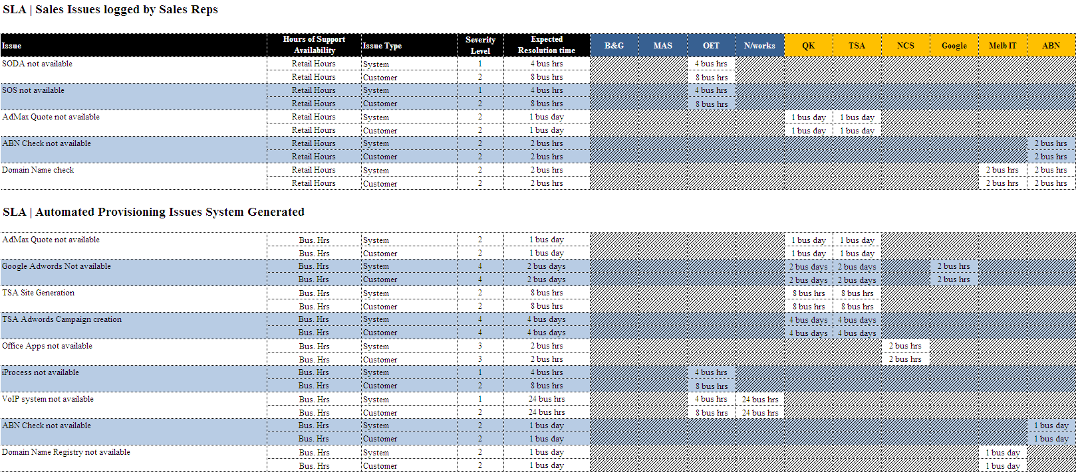
ODA - SLA

Slide 12

Project ODA : Key Txn Workflow and Systems
Sales &Provisioning Team
1
Customer request quote externally
Customer request quote/order via CSR
CSR can retrieve customer quote
2
SODA Quote
External Facing Website
2
3
10
CSR provision order in SOS Arbor and
Order details send to OPOM & MTS
1
Vertica extract file
3
SOS
Arbor
4
CSR cut and paste order details from
SOS to SODA
4
ABN Registry
5
SODA passes the order to iProcess
SODA Quote/Order
Internal Facing Website
6
iProcess verifies SOS order details from
MTS
Melbourne IT
OPOM
7
iProcess sends deploy website request
to TSA
5
8
TSA Deploy Call back confirmation to SODA
iProcess
6
9
Customer log-in through SAS connect
To update website
MTS
8
Customer calls extrract edfrom Vertica
Sends to SODA to be displayed in
Websitedashboard
7
10
TSA
11
Customer Statistical info for reporting sends via DCS to IDW
11
DCS
IDW
11
TSA Interface with Google
12
Customer SEO
Website
Manual Update
Google
New applications
BAU – No change
SaaS Connect
Reporting – IC update
9
Non Optus change
12
Notes:
12
12

Slide 13


SODA Quote Interface
Customer Usage
TSA Front Jboss
https://myoptus.com.au/quote
Choc
Rever s
e
Proxy
WAM Site Minder
https 8443
www.obtusbusiness.com.au
TCP 80
SODA Quote
customer
Web browser
SODA & iProcess Database
TCP 1831
Email notification
SMTP Server

Slide 14

SODA Quote/ Order - SEO
NCS
Google
Optus CSR
Customer Usage
https://myoptus.com.au/quote
Web Site Hosting
TSA
Web Site Hosting
SODA Quote/Order
iProcess
Workflow
Customer
Joe the Plumber
Email notification
MTS
Public Customer looking for a Plumber
Vendor Deliverable
ABN Registry
Melbourne IT
Domain Registry
SOS OPOM
External Interface
Config Change
Optus Retail Store
Arbor
Optus Deliverable

Slide 15




Public Customer Interface to the Website
Public customer
TSA Customer Webservers
Customer Usage
Tel No: 999-8888
Optus Mascot Reverse proxy
Manual call redirection
to business preferred no
Customer
TSA Logs public customer hits on the website
External ip address1
TSA Pixel1
External ip address1
TSA Pixel2

Slide 16

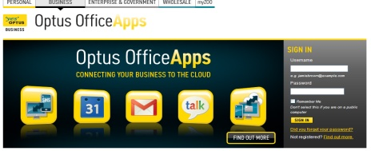
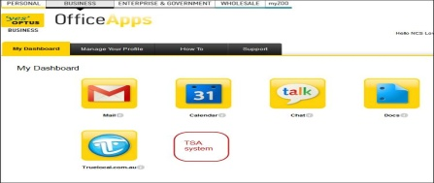


Self Serve UI and NCS SaaS Connect Integration
2
SaaS Connect
http://www.optusofficeapps.com.au
Customer Usage
ODA Mascot revere Proxy
1
3
http://www.odass.sit.optusnet.com.au
4
Business Customer
Self Serve UI
Customer
Webservers
ODA Mascot forward Proxy
Front Jboss
5
6
Acct DB
Warehouse DB
1
User access Office Apps URL
2
User clicks on ODA Icon
Pixel Servers
TSA Admax
Bid Budget
3
User directed to Self Serve -
www.odass.sit.optusnet.com.au
TSA back jboss
4
TSA sends authentication request to
SaaS connect and sends confirmation back
5
TSA validates confirmation and allow
User to access Self serve
iProcess
Customer Website updates request
sends to iProcess
6

Slide 17
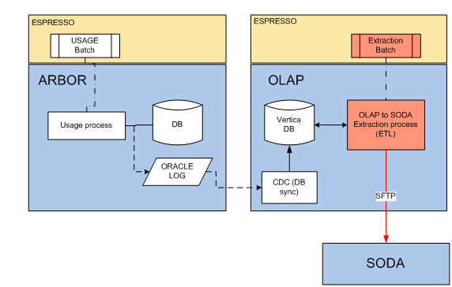
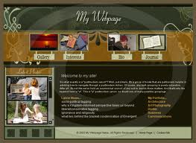
OLAP to SODA Interface
Customer Usage
Customer
Daily
TSA
iProcess
Customer Usage info (number of calls and relevant dates generated from the website are extracted from Vetica and send to SODA
SODA sends usage info to TSA via iProcess to be displayed onto the Customer Website dashboard .

Slide 18
Why the need for BETA Release Production
Following the ODM methodology his is a greenfield application. Some testing scenarios can only be executed in a real production environment Test outcomes will be used to finalise T&C’s and system config prior to commercial launch. E.g. the actual time to complete E2E Website deployment in the real world (system to be configured with the average delay time)
Infrastructure Shakedown E2E Connectivity – current complexity requires considerable amount of testing User Access Configuration Proxy /HA Configuration
Business - Service Assurance Exception scenarios for Customer Provisioning Billing Provisioning Browser Compatibility (Mobile & Desktop) VoiP Diversion
Website Deployment in Production Order provisioning from SODA → iProcess →TSA → iProcess Monitor actual time to reserve/create and propagate DNS in the internet
DNS reservation & dynamic creation (Melbourne IT)
iProcess to SaaS Connect - Customer Login, Customer ID, Package Creation
TSA to SaaS Connect Self Serve UI

